Slide 2

EYE-DEFECTS
Normal eye
The image is formed on the retina

Slide 3

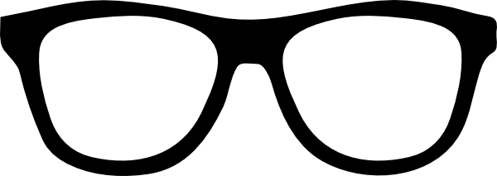
EYE DEFECTS
MYOPIA
NEAR SIGHTEDNESS
HYPERMETROPIA
FAR SIGHTEDNESS

Slide 4


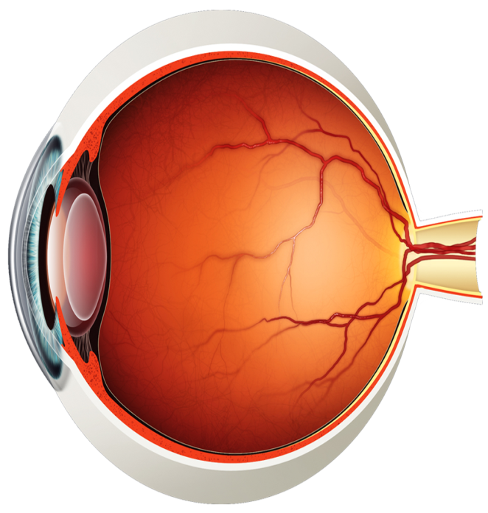

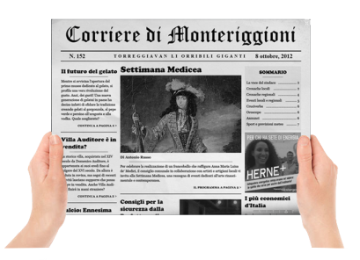
Myopia (Near sightedness)
Nearby
object
Faraway
object
Patient view

Slide 5

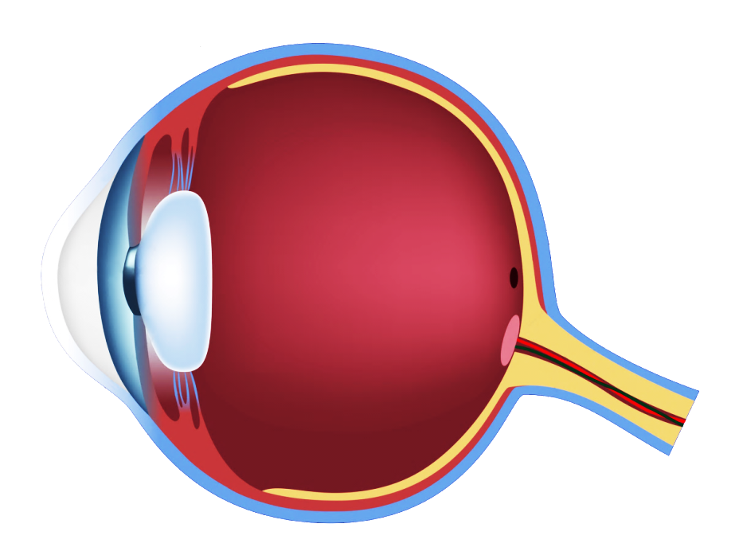

Myopia (Near sightedness)
Normal Eye

Slide 6
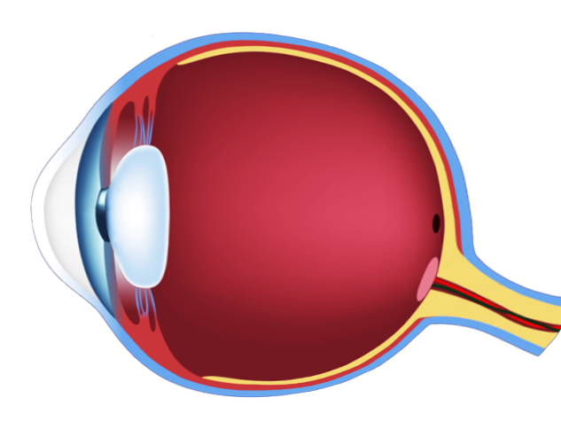

Myopia (Near sightedness)
Defected Eye
This defect may arise due to elongation of the eyeball.
The light rays from a distant object arriving at the eye lens, get converged at a point in front of the retina

Slide 7

Myopia (Near sightedness)
Correction
This defect can be corrected by using a concave (diverging) lens of appropriate focal length.

Slide 8
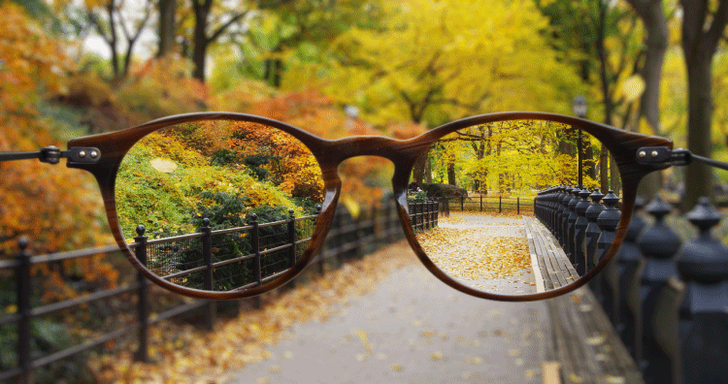


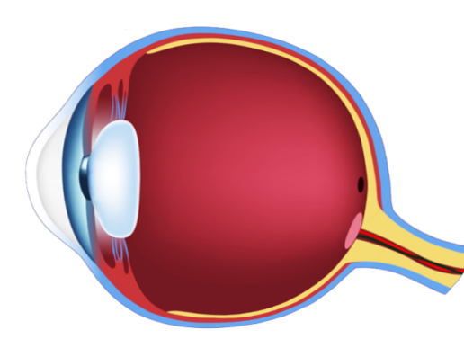

Myopia (Near sightedness)
Far point
Nearby objects
Clear
Faraway objects
Unclear
The light rays from a distant object, get converged at a point in front of the retina
Myopic Eye
This defect may arise due to
1. Elongation of the eyeball.
2. Excessive curvature of the cornea and eye lens.
Correction
Corrected using a CONCAVE (diverging) lens of appropriate focal length.
Power of the lens is – ve

Slide 10
MYOPIA
NEAR SIGHTEDNESS
HYPERMETROPIA
FAR SIGHTEDNESS

Slide 11

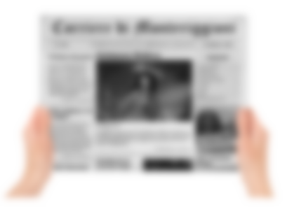
Hypermetropia (Far sightedness)
Nearby
object
Faraway
object
Patient view

Slide 12
Hypermetropia (Far sightedness)
Normal Eye

Slide 13
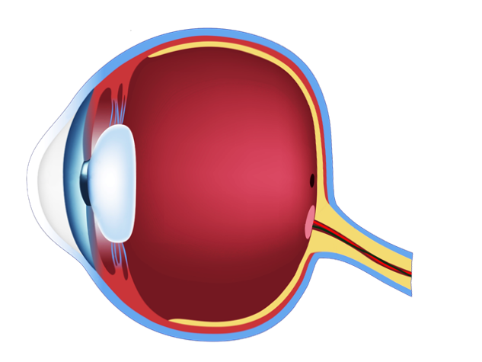
Hypermetropia (Far sightedness)
Defected Eye
This defect may arise due to shortening of the eyeball.
The light rays from a nearby object arriving at the eye lens, get converged at a point behind the retina

Slide 14
Hypermetropia (Far sightedness)
Correction
This defect can be corrected by using a convex (converging) lens of appropriate focal length.

Slide 15
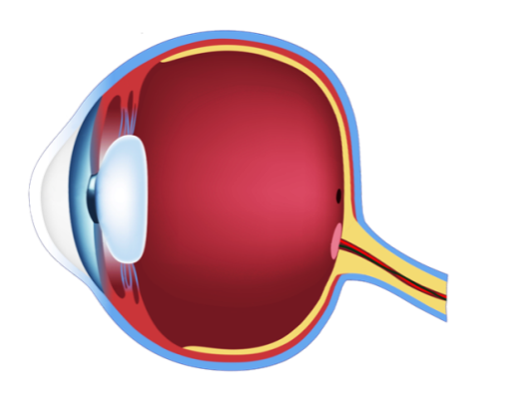
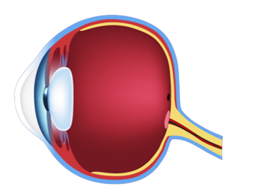
Hypermetropia (Far sightedness)
Near point
Faraway objects
Clear
Nearby objects
Unclear
The light rays from a nearby object arriving at the eye lens, get converged at a point behind the retina
Hypermetropic Eye
This defect may arise due to
1. Eyeball gets flattened.
2. Curvature of the cornea and the eye lens decreases.
Correction
Corrected using a CONVEX (converging) lens of appropriate focal length.
Power of the lens is + ve

Slide 16
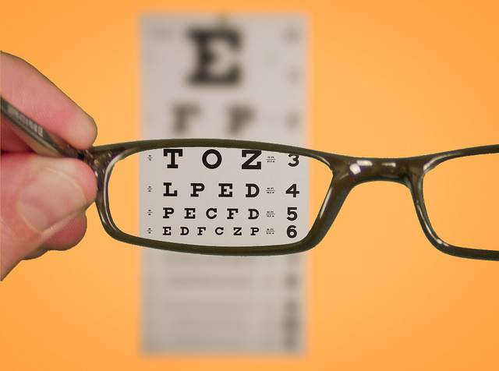

Slide 17

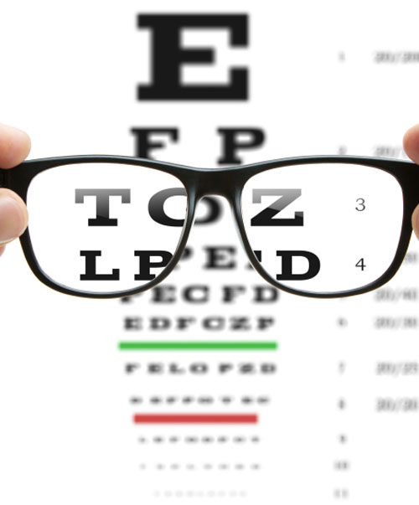
EYE-DEFECTS
Presbyopia (Old age hypermetropia)
Faraway objects
Clear
Nearby Objects
Unclear
Old age (Above 40 years)
Muscles near the lens lose their ability to change the focal length.
Near point (25 cm) shifts farther from eye.
Correction: Convex lens of suitable focal length.

Slide 18
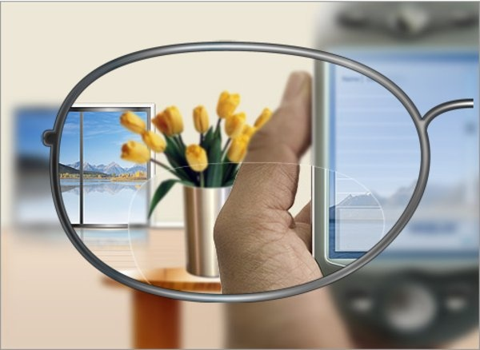
EYE-DEFECTS
Some people develop a combination of myopia and presbyopia in which they are not able to see near as well as far away objects clearly.
Bifocal lens
Upper part is concave to correct myopia
Lower part is convex to correct hypermetropia

Slide 19

Distinguish between Myopia and Hypermetropia
Myopia
Hypermetropia
A person can see nearby
objects clearly.
A person can see faraway
objects clearly.
This defect arises due to the elongation of eye ball.
This defect arises due to the flattening of eye ball.
The image of a distant object is formed in front of the retina.
The image of a nearby object is formed behind the retina.
This defect is corrected by the use of concave lens of suitable focal length.
This defect is corrected by the use of convex lens of suitable focal length.

Slide 20
Thank You

